Slide 1
FOOD ADULTERATION
Guide Details: Student Details:
D Sheetal Sharma(b. Tech , M. Tech) NAME : Vadisela .Jaya sri
Assistant professor, REGD.NO.:22331A12B1
Department of IT, Sec : IT-B
MVGR college of engineering

Slide 2
Abstract
Food adulteration is a growing concern affecting public health, leading to severe diseases and reduced food quality. Many consumers are unaware of common adulterants and their harmful effects. The food adulteration is a web-based solution designed to educate users about food safety. The system allows users to check for adulterants in food, access advantages and disadvantages of food items, and learn testing methods. It also provides real-time food safety updates and enables users to report adulteration cases. By integrating awareness, reporting, and testing, this system empowers consumers to make informed choices and promote food safety.

Slide 3
Introduction
Food adulteration refers to the addition of harmful substances to food, reducing its quality and posing health risks. Many common food items like milk, spices, and oils are adulterated, leading to severe health conditions. The lack of awareness and accessibility to testing methods makes it difficult for consumers to ensure food purity. The food adulteration is designed to provide a user-friendly platform where users can enter a food item and receive information on adulterants, advantages, and disadvantages. Additionally, the system includes a reporting feature for users to submit suspected adulteration cases. This initiative helps in creating awareness, improving food safety, and preventing health risks.

Slide 4
Problem Statement
Food adulteration is a serious health issue, often going unnoticed by consumers .Existing detection methods are costly, time-consuming, and inaccessible to the general public .There is no centralized platform that provides easy access to food adulteration information .Consumers lack awareness of home-based food testing methods .There is no digital system where users can report adulteration cases to relevant authorities .Scattered and unreliable sources of food safety information create confusion among consumers .A structured, automated system is needed to spread awareness and ensure safer food consumption.

Slide 5
System requirements
Software requirements:
Operating System: Windows
Frontend: Html , CSS , JavaScript
Backend: PHP
Database: MYSQL
Web server : Localhost
Hardware requirements:
Processor: intel i3 or higher
RAM: 4GB or higher
Storage: 100GB HDD or SSD
Server: Apache or any local web server
Internet connection for online access

Slide 6
Existing system
Consumers rely on traditional knowledge or expensive lab tests to check for food adulteration.
No centralized database for food safety awareness and home testing methods.
Lack of a proper reporting system for food adulteration complaints.
Information about food adulteration is scattered across different sources.
Consumers are unaware of simple and effective adulteration detection methods.

Slide 7
Proposed system
A web-based platform that provides information on food adulteration, advantages, and disadvantages.
Allows users to enter a food item and receive relevant details.
Step-by-step guide for home-based food adulteration tests.
Reporting system for users to submit cases of suspected adulteration.
MYSQL database for storing food-related data and reports.
Regular updates on food safety news and research.
Enhances awareness and promotes consumer safety.

Slide 8
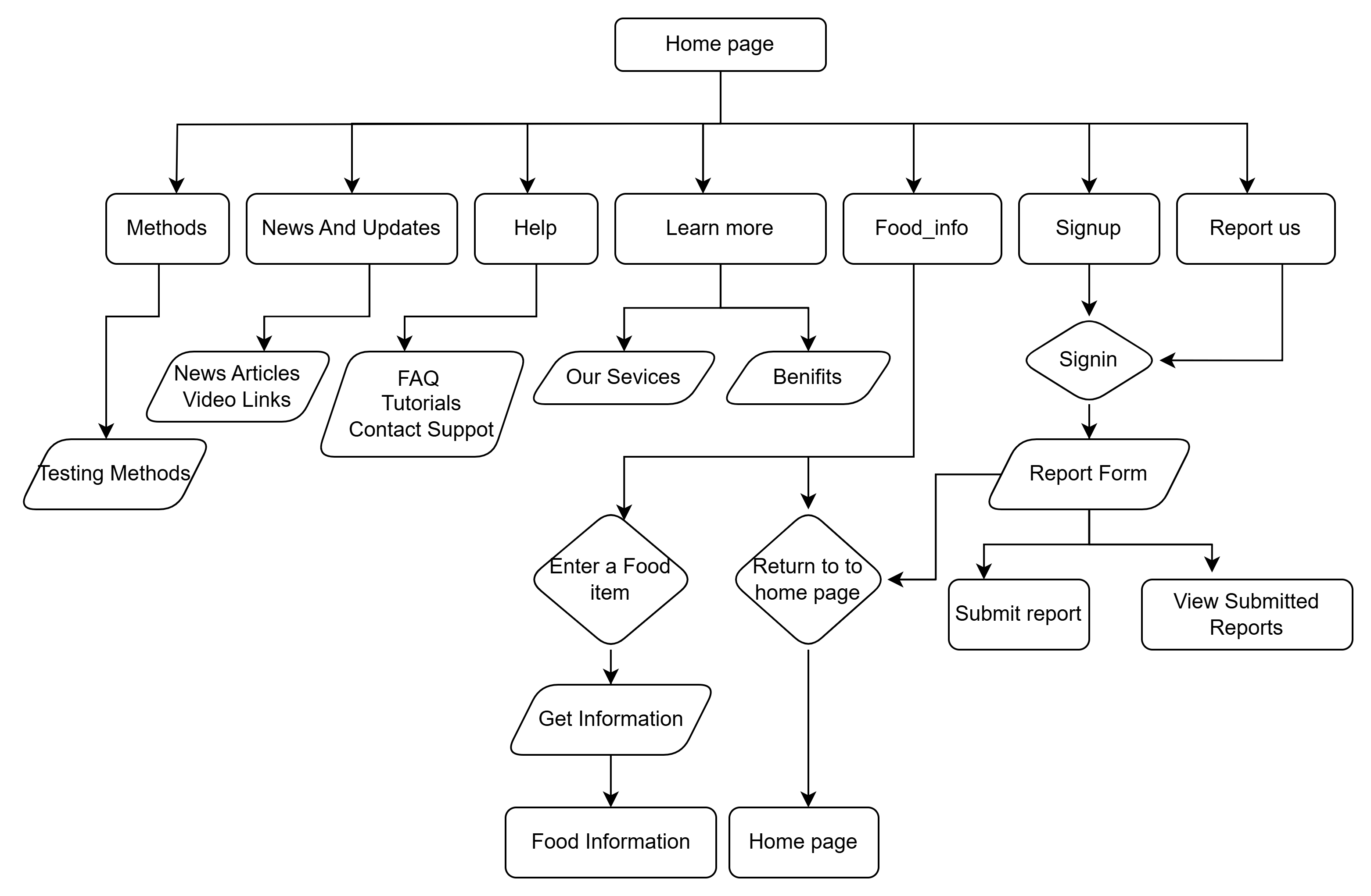
methodology

Slide 9
TECHNOLOGIES USED
Frontend: HTML, CSS, JavaScript for UI development
Backend: PHP for server-side logic
Database: MYSQL for storing food data and reports
API integration: to fetch food safety updates
Security measures: user authentication and data protection mechanisms

Slide 10
Implementation Procedure
Requirement analysis – define key features and choose PHP, MYSQL, HTML/CSS, JavaScript.
Database design – create tables for Food info, inquiries, and users in MYSQL.
Backend development – implement food search, report submission, and authentication using PHP.
Frontend development – design user-friendly UI for food info and reports.
Report submission – users submit food adulteration reports, stored in MYSQL.
Testing – perform unit, integration, and security testing.
Deployment – host on a web server and ensure maintenance.

Slide 11
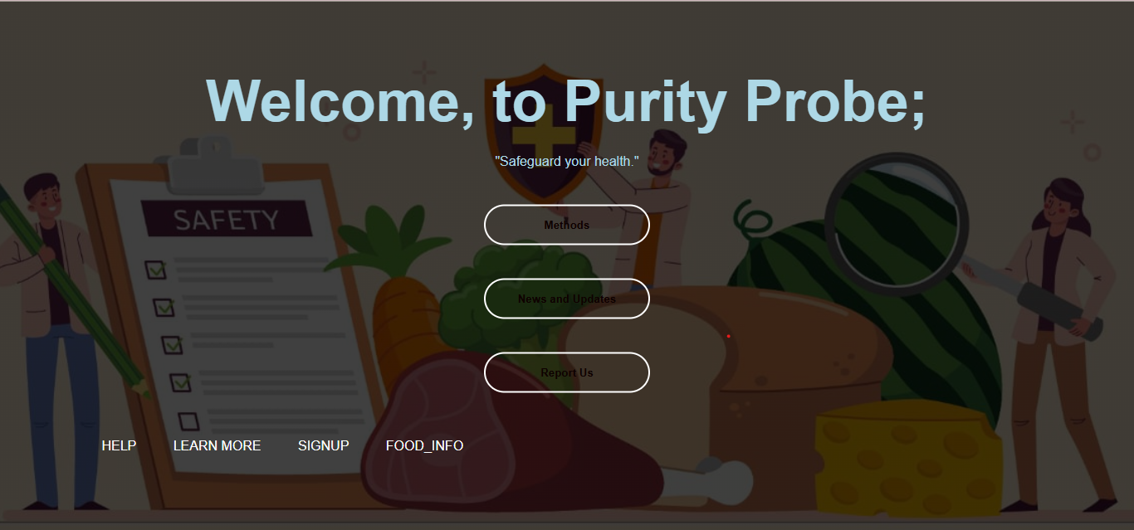
RESULTs

Slide 12
ADVANTAGES AND LIMITATIONS
Advantages
Easy access to food adulteration information.
Step-by-step guidance for home-based tests.
Users can report food adulteration cases.
Centralized database for food safety awareness.
Increases public awareness of safe food choices.
Limitations
Relies on users reporting cases for data collection.
Does not replace advanced laboratory testing.
Internet connection required for real-time updates.

Slide 13
CONCLUSION
The food adulteration is an innovative solution to educate consumers about food safety. By providing information on food adulteration, detection methods, and a reporting system, the platform enhances consumer awareness. The integration of a MYSQL database ensures efficient data management, while the web-based interface makes it accessible to users. This system contributes to public health by empowering people to identify and prevent food adulteration.

Slide 14
REFERENCES
Food safety and standards authority of INDIA (FSSAI) –
Https://www.Fssai.Gov.In
Adulteration testing methods – national institute of nutrition (NIN) –
Https://www.Nin.Res.In

